Slide 1
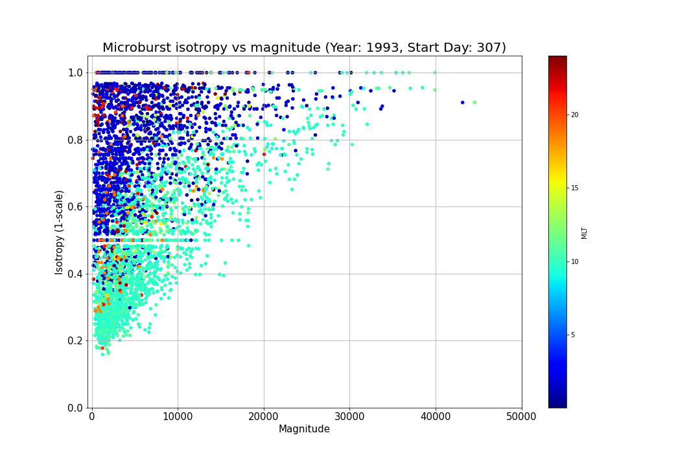
Microburst Isotropy vs Magnitude

Slide 2
Correlation Check
The Isotropy vs Magnitude correlation found when observing microbursts during a week period geomagnetic storm must be analyzed to ensure no calculation errors
To analyze this correlation, we will break down the calculations for both the microburst isotropies and microburst magnitudes

Slide 3
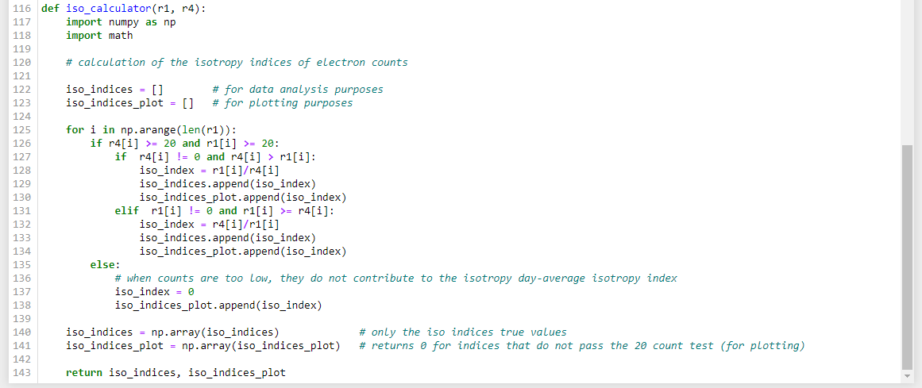
Microburst Isotropy
Code:
Formula:
Isotropy Index = (lower SSD count) / (higher SSD count)

Slide 4
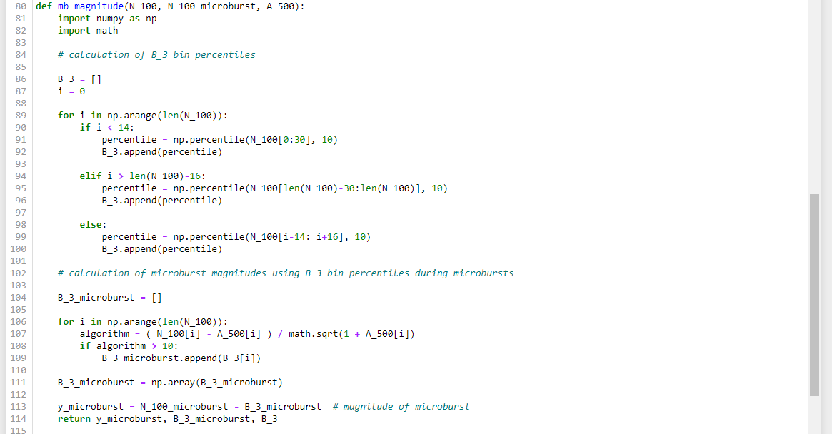
Microburst Magnitude
Code:
Formula:
Magnitude = (SSDs count sum) – (3-sec bin 10th percentile)

